Slide 1
Value addition of 5g
By Nasiru Hayatu

Slide 2





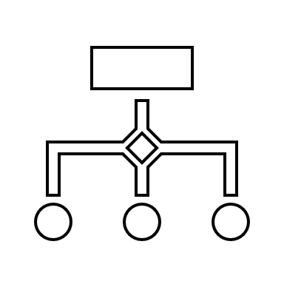
The World of 5G
5G is expected to significantly enhance the mobile network, enabling more connections and interactions.
This connectivity enhancement across networks will unlock significant potential for various industries to improve their bottom line.
5G relative to 4G
10x better throughput
More uniform multi-Gbps peak data rates
10x lower latency
As low as 1ms
10x connection density
Enabling more effective signaling for IoT connectivity
3x spectrum efficiency
Achieving more bits per Hz with advanced antenna techniques
100x traffic capacity
Driving hyper-densification of network with more small cells
100x network efficiency
Optimizing network energy consumption with more efficient processing

Slide 3
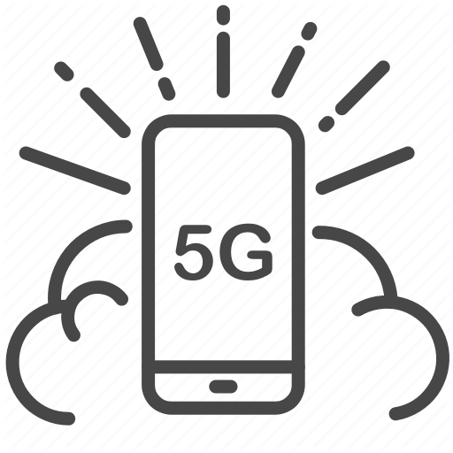
Functional Drivers
The key functional drivers of 5G will unlock a broad range of opportunities, including the optimization of service delivery, decision-making and end-user experience
1
EMBB – Enhanced Mobile Broadband
Faster connections, higher throughput and greater capacity. Allows for an extension in cellular coverage into diverse structures (large venues) and the ability to handle a larger number of devices using high amounts of data
Use Cases Include
Fixed Wireless Access Service
Enhanced in-building broadband service
Real-time augmented reality service
Real-time virtual and mixed reality service
Crowded or dense area service
High-definition cloud gaming
Public protection and disaster response services
Massive content streaming services
Remote surgery and examination
Enhanced Digital Signage

Slide 4
Functional Drivers
2
Ultra-reliable low latency communication (uRLLC)
Enables time-sensitive connections wirelessly . Reduced time for data from device to be uploaded and reach its target (1 ms compared to 50ms for 4G). Creates an ultrareliable connection to support applications where failure is not an option
Use Cases Include
Autonomous vehicles
Drones and robotic applications
Health monitoring systems/telehealth
Smart grid and metering
Intelligent transportation
Factory automation
Remote operation
Self-driving cars
Mission-critical services (security and safety)
High-definition real-time gaming

Slide 5

Functional Drivers
3
Massive machinetype communications (mMTC)
Allows for a large number of connections to support data-intensive applications
Use Cases Include
Asset tracking and predictive maintenance
Smart cities/buildings/agriculture
Internet of energy/utility management
Industrial automation
Smart logistics (advanced telematics)
Smart grid and metering
Smart consumer wearables
Environmental management
Intelligent surveillance and video analytics
Smart retail

Slide 6
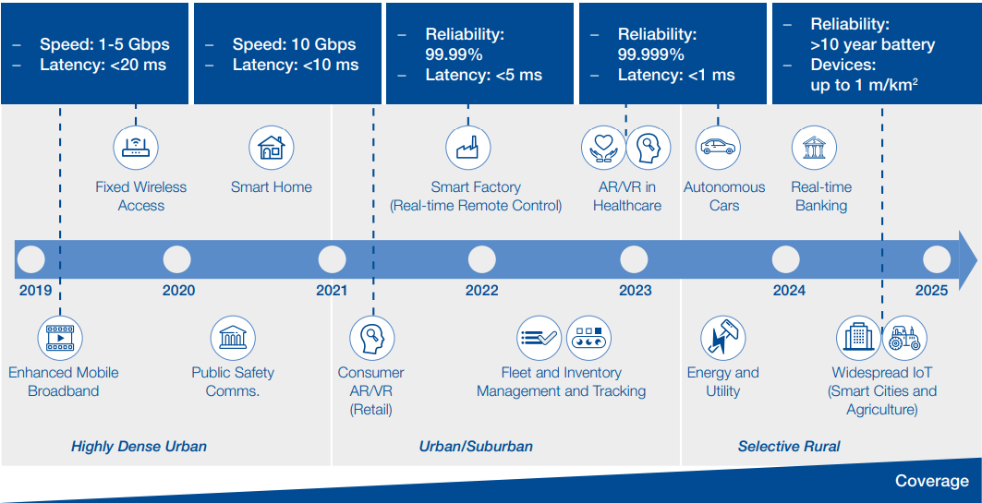
Opportunities 5G unlocks
The economic value that 5G can create can be identified through potential industrial advancement areas and subsequent major commercial opportunities across industry sectors:
Source: PwC Strategy& and World Economic Forum, “5G for the Fourth Industrial Revolution”, 2019

Slide 7


Macroeconomic benefits of 5G
It is estimated MMWAVE deployment will contribute about $5.2b to the Sub-Saharan Africa GDP by 2034 (i.e. 0.7% of GDP growth). Nigeria is set to contribute about 20% of this figure ($1.04b).
Other Socio-economic benefits of 5G deployment…
Increased productivity and safety in manufacturing, mining and construction through development of smarter factories and machinery, enabling redeployment of human resources and higher-quality outputs
Increased productivity
Canada
Russia:
USA
South Korea
Increased availability and access to good healthcare services at lower cost (via video/telemedicine, tactile internet).
Mexico
Central America
Israel
India: 30
China
Japan
Egypt
Thailand
Taiwan
Nigeria
Malaysia
Philippines
Brazil
Singapore
Indonesia
Southern Cone
South Africa
Australia
New Zealand
Day-to-day safety may be enhanced by broadband-enabled first responder communications, as well as new and improved tools to provide first responders with the data or support needed to address situations most effectively
Taxes to be generated from MMWAVE deployment is estimated to be roughly $970m for the whole of SSA. We can assume that Nigeria will contribute about 20% of this figure as well
Increased public safety/ emergency response
Source: 2018 GSMA Study on socio –economic benefits of 5G services provided in mmwave bands

Slide 8

Value Addition of 5G to industries and the society
Industry sector | Current Industry Trends | Sample use cases | SDG impacted | Transformation enabled by 5G
Manufacturing | –Hyper-competition with no sustainable competitive advantages – Increasing volatility from business cycles and product life cycles – Smart factory advances due to developments in the internet of things and automation – The need to securely connect systems on a common infrastructure – Increasing consumer demand for customized and personalized products – Demand for products that are more complex to build and deliver | –Smart factory floor –Human-to-robot collaboration – Predictive maintenance – Digital twins – Augmented reality – Virtual reality – Digital performance management | SDG 7 SDG 8 SDG 9 SDG 12 SDG 13 | –Advanced predictive maintenance can lead to enhanced equipment availability and throughput. – Remote maintenance can lead to lower operational costs. – Digital performance management and digital standard operating procedures result in enhanced operational efficiency. – Factories of the future have smart, automated manufacturing.
Transportation | – Autonomous driving and a connected traveller with telematics – Car sharing and changing commuter habits – Electric mobility with the green agenda – Digital vehicle ecosystem – Infotainment on the move – Urbanization and intermodality – Environmental awareness and public spaces – Urban lifestyle and growing expectations on public transport | – Digital twin (predictive maintenance) – High-density platooning and automation – Smart traffic control with prioritization – Remote vehicle health monitoring – Massive media car infotainment – Airborne taxis – Vehicle-to-vehicle | SDG 3 SDG 7 SDG 9 SDG 11 | – Autonomous mobility as a reality leads to enhanced individual productivity (less time spent on driving). – Green and sustainable mobility reduces environmental impacts.
Healthcare | – Increasing consumer attention on well-being – Increasing cost to meet socio-demographic changes – Increasing demand on quality, patient safety and data storage – Changing consumer behaviour, freedom of choice and alternative service providers | – Remote patient monitoring – Internet of medical skills/remote surgery – Image transfer – AR/VR-enabled healthcare – Disease management – Wearables and ingestibles – Drone-enabled medical service delivery | SDG 3 SDG 4 SDG 5 SDG 8 SDG 9 | m-Health (mobile health) and the wider introduction of telemedicine result in increased accessibility to quality healthcare. – Preventive healthcare measures (wearables and ingestibles) lead to decreased long-term healthcare costs.
Financial services | Disruption from fintech (technology used to support financial services) due to online payments, e-wallets, etc. – Challenging customer relations with online/ mobile transactions and customized financial solutions – Structural changes: state involvement, protectionism and fiscal measures | -- Mobile banking: centre of all banking transactions – Wearables for payment – Virtual personalized financial advisory – Internet of moving things – Digital deposits, payments and peerto-peer lending – Mobile as a digital wallet – Remote teller | SDG 4 SDG 5 SDG 8 SDG 9 SDG 13 | – Shorter settlement cycles in capital markets lead to enhanced economic activity. – Virtual personalized services and all-in-one mobile wallets enhance the customer experience.

Slide 9
Value Addition of 5G to industries and the society
Industry sector | Current Industry Trends | Sample use cases | SDG impacted | Transformation enabled by 5G
Retail | -- Omni-channel retail strategies – Personalized retail experience – Growing culture of immediacy – Increasing relevance of digital mobile wallets – Faster e-commerce shipping – Rising subscription -- e-commerce | – Consumer 3D calls/ holograms – Consumer AR/MR – Automated checkout – Layout optimizations – Smart customer relationship management – In-store personalized promotions – Inventory shrinking prevention | SDG 2 SDG 3 SDG 8 SDG 12 SDG 13 | – Try-before-you-buy using AR/VR results in an enhanced consumer experience. – Customized in-store advertisements lead to increased sales.
Energy | – Electrification and renewable energy generation – New decentralized business models – Structural shifts with increasingly retiring assets – Political and societal push for sustainable energy systems – Production and transmission assets often located in remote locations – Need for improved customer engagement | -- Smart grid – Drone monitoring capabilities – Smart energy management – Hazard and maintenance sensing – Electric vehicles – Residential smart meters – Smart street lighting | SDG 7 SDG 8 SDG 9 SDG 13 | -- Smaller plants dependent on renewable energy and smart grids enhance reliability and availability. – Demand-side integration with suppliers unlocks commercial opportunities for suppliers. – The digitization of gas networks leads to faster decision-making, minimizing potential losses.
Entertainment/ media | Consumers of content acting as content cocreators – Increasingly interactive and immersive forms of entertainment – A new sensory dimension to entertainment – Expansion of digital content through new platforms and market players – Ecosystem complexity | Immersive media applications (ultrahigh-definition, AR, VR) – Live in-stadium experiences – Connected haptic suites – 3D holographic displays – Gaming (AR and cloud gaming) – Home entertainment subscription for car – In-venue media | SDG 3 SDG 4 SDG 5 | – Content-fuelled interactions igniting emotional connections lead to increased customer expenditure. – The consumer as content co-creator results in increased consumer engagement. – Gamification is induced in other industries.
Source: ITU, 2018.

Slide 10
Opportunity for Entrepreneurs
5G would make digitalization more accessible, allowing small businesses, public services and even individual households to reap the benefits of smart products and services. Billions of people across the planet will have the power of high-speed internet wherever they are, opening the door for almost limitless innovation.
Additionally, 5G has the potential to provide quality internet access to geographical areas that are currently underserved by the telecommunications network. This could unlock significant social impact through use cases related to tele-education and telemedicine
Generally,
5G Technology will foster development of innovation
5G Technology will facilitate innovations in remote work opportunities.
5G Technology will enhance innovations in Supply Chains.
5G Technology will actuate the development of innovations in Digital Marketplaces.
5G creates opportunities that enable the creation of new business models, products and services around these technological advancements by providing faster and better connectivity.

Slide 11
Opportunity for Entrepreneurs
In Nigeria, Small and Medium Enterprises (SMEs), especially fintech and e-commerce firms, are currently expanding the digital ecosystem by riding on telecoms infrastructure, the e-commerce platforms and fintech in Nigeria would benefit immensely from 5G technology to deliver more innovative and high-quality experiences to consumers.
5G provides the platform for new and emerging technologies such as the Internet of Things (IoT), Artificial Intelligence (AI) and Big Data to improve the way people live and work. 5G network will transform Nigeria into a ‘smart city’, improve its economic growth and migrate it to a digital economy.
Other areas of opportunity where entrepreneurs can leverage the adoption of 5G in Nigeria is in the area of smart transportation, gaming, efficiency in medicine as well as a lot of automation with respect to our appliances and devices (IoT).
5G is a game changer. Businesses and entrepreneurs need to leverage on it to make a difference, adopt smarter ways of working and have a competitive edge
In conclusion, 5G will be the ”glue” that will tie all of our devices, buildings, and cities together, enabling new and smarter, faster ways of working for all of us.

Slide 12
Thank YOU

